Slide 1
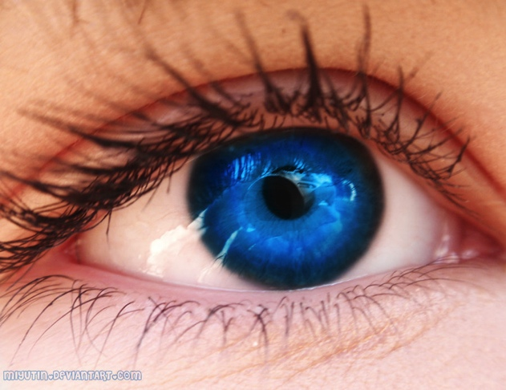
236860
Lecture 4
Digital Image Processing
Discrete domain signals & systems
Alex Bronstein

Slide 2







Sampling and periodization
Continuous
Discrete
$$f\left(x\right) x∈ℝ^{d}$$
Signal
Sampled on${ ℒ}^{∗}={A^{∗}ℤ}^{d}={A^{−T}ℤ}^{d}$
$$f\left(A^{∗}n\right)$$
Fourier transform
Periodized on$ℒ={Aℤ}^{d}$
$$F\left(ξ\right)$$
$$\tilde{F}\left(ξ\right)=\sum_{n∈ℤ^{d}}{F(ξ−An) }$$
$ℒ_{0}=A{\left[−\frac{1}{2},\frac{1}{2}\right]}^{d}$-periodic

Slide 3



Discrete domain Fourier transform
$$\tilde{F}\left(ξ\right)$$
is $A{\left[−\frac{1}{2},\frac{1}{2}\right]}^{d}$-periodic
Can be fully described by its content on $A{\left[−\frac{1}{2},\frac{1}{2}\right]}^{d}$
Normalized (a.k.a. digital) frequency ${ω∈\left[−\frac{1}{2},\frac{1}{2}\right]}^{d}$
Discrete-domain Fourier transform $F\left[ω\right]=vol ℒ⋅\tilde{F}\left(Aω\right)$

Slide 4








Discrete domain Fourier transform
$$F\left[ω\right]=vol ℒ⋅\tilde{F}\left(Aω\right)$$
$$= ({vol ℒ⋅III}_{ℒ}∗F)\left(Aω\right)$$
$$=\sum_{p∈ℒ^{∗}}{f(p){⋅ℱ(τ}_{p}δ)\left(Aω\right)}$$
$$=ℱ({III}_{ℒ^{∗}}⋅f)\left(Aω\right)$$
$$=\sum_{p∈ℒ^{∗}}{f\left(p\right)φ_{−p}\left(Aω\right)}$$
$$=\sum_{n∈ℤ^{d}}{f\left(A^{∗}n\right)e^{−2πi{\left(Aω\right)}^{T}A^{∗}n}}$$
$$=\sum_{n∈ℤ^{d}}{f\left(A^{∗}n\right)e^{−2πiω^{T}n}}$$
$$=\sum_{n∈ℤ^{d}}{f[n]e^{−2πiω^{T}n}}$$

Slide 5



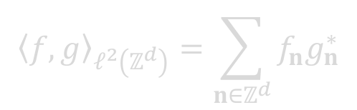


Discrete domain Fourier transform
Discrete-domain signal
$$f\left[n\right]=f(A^{∗}n)$$
$${\left\langle f,g\right\rangle }_{ℓ^{2}\left(ℤ^{d}\right)}=\sum_{n∈ℤ^{d}}{f_{n}g_{n}^{∗}}$$
Discrete-domain Fourier transform
$$=\sum_{n∈ℤ^{d}}{f[n]e^{−2πiω^{T}n}}$$
$$F\left[ω\right]=vol ℒ⋅\tilde{F}\left(Aω\right)$$
$$={\left\langle f,φ_{ω}\right\rangle }_{ℓ^{2}(ℤ^{d})}$$
Inverse Fourier transform
$$f\left[n\right]=\int_{{\left[−\frac{1}{2},\frac{1}{2}\right]}^{d}}{F[ω]}e^{2πiω^{T}n}dω$$
Properties inherited from continuous domain

Slide 6









Discrete domain systems
$f∈$ $ℒ_{0}$-band limited
$$g=h∗f$$
$g[n]$ sampled on $ℒ^{∗}$
$$\underset{↔}{ ℱ } vol ℒ⋅{III}_{ℒ}∗(F⋅H)$$
$${III}_{ℒ^{∗}}⋅g=$$
$${III}_{ℒ^{∗}}⋅(f∗h)$$
$$=({III}_{ℒ^{∗}}⋅f)∗({III}_{ℒ^{∗}}⋅h)$$
$$=vol ℒ⋅{(III}_{ℒ}∗F)⋅{(III}_{ℒ}∗H)$$

Slide 7







Discrete domain systems
$${III}_{ℒ^{∗}}⋅g=$$
$${III}_{ℒ^{∗}}⋅(f∗h)$$
$$=({III}_{ℒ^{∗}}⋅f)∗({III}_{ℒ^{∗}}⋅h)$$
$$=\left(\sum_{p∈ℒ^{∗}}{f\left(p\right)τ_{p}δ}\right)∗\left(\sum_{p∈ℒ^{∗}}{h\left(p\right)τ_{p}δ}\right)$$
$$=\sum_{p,q∈ℒ^{∗}}{f\left(p\right)h(q)τ_{p+q}δ}$$
$$=\sum_{s∈ℒ^{∗}}{\left(\sum_{q∈ℒ^{∗}}{f\left(p\right)h(s−p) }\right)τ_{s}δ}$$
$$s=p+q$$
$$=\sum_{m∈ℤ^{d}}{\left(\sum_{n∈ℤ^{d}}{f\left(A^{∗}n\right)h(A^{∗}(m−n)) }\right)τ_{A^{∗}m}δ}$$

Slide 8





Discrete domain systems
$$\sum_{m∈ℤ^{d}}{\left(\sum_{n∈ℤ^{d}}{f\left(A^{∗}n\right)h(A^{∗}(m−n)) }\right)τ_{A^{∗}m}δ}$$
$${III}_{ℒ^{∗}}⋅g=$$
$$=\sum_{m∈ℤ^{d}}{\left(\sum_{n∈ℤ^{d}}{f\left[n\right]h[m−n] }\right)τ_{A^{∗}m}δ}$$
$$=\sum_{m∈ℤ^{d}}{g[m]τ_{A^{∗}m}δ}$$
$$g\left[m\right]=\sum_{n∈ℤ^{d}}{f\left[n\right]h[m−n] }$$
$$=\left(f∗h\right)[m]$$
discrete convolution

Slide 9



Kroenecker’s delta
Continuous convolution:
$$f∗δ=f$$
Discrete convolution:
$$f∗δ=f$$
Kroenecker’s delta sequence
$$δ_{n}=\left\{\begin{matrix}1 & : n=0 \\ 0 & : n≠0\end{matrix}\right.$$

Slide 10

















Discrete domain translation
$f$ is $ℒ_{0}$-band limited on general lattice$ℒ={Aℤ}^{d}$
Continuous domain translation
Fourier domain
$$g\left(x\right)={(τ}_{p}f)(x)$$
$$=f(x−p)$$
$$\underset{↔}{ ℱ }$$
$$G\left(ξ\right)$$
$$=F\left(ξ\right)⋅φ_{−p}\left(ξ\right)$$
$$↓ ⋅III_{ℒ^{∗}}$$
sampling on $ℒ^{∗}$
$$↓ ∗vol ℒ⋅III_{ℒ}$$
periodization on $ℒ^{}$
$$G\left(ξ\right)$$
$$=vol ℒ F\left(ξ\right)⋅φ_{−p}\left(ξ\right)$$
Discrete domain translation
$$g\left[n\right]=g\left(A^{∗}n\right)$$
$$=f(A^{∗}n−p)$$
$$G\left[ω\right]=vol ℒ F\left(Aω\right)⋅φ_{−p}\left(Aω\right)$$
$$=\left(f∗ℱ^{−1}(e^{−2πi p^{T}Aω })\right) [n]$$
$$=F\left[ω\right]⋅e^{−2πi p^{T}Aω }$$

Slide 11







Discrete domain translation
$$ℱ^{−1}\left(e^{−2πi p^{T}Aω }\right)\left[n\right]=$$
$$\int_{{\left[−\frac{1}{2},\frac{1}{2}\right]}^{d}}{e^{−2πi {\left(A^{T}p\right)}^{T}ω }}e^{2πin^{T}ω}dω$$
$$=\int_{{\left[−\frac{1}{2},\frac{1}{2}\right]}^{d}}{e^{2πi{(n−q)}^{T}ω}}dω$$
$$q=A^{T}p$$
$$=\int_{{\left[−\frac{1}{2},\frac{1}{2}\right]}^{}}{e^{2πi{(n}_{1}−q_{1})ω_{1}}}dω_{1}⋅⋯⋅\int_{{\left[−\frac{1}{2},\frac{1}{2}\right]}^{}}{e^{2πi(n_{d}−q_{d})ω_{d}}}dω_{d}$$
$$=sinc \left(n_{1}−q_{1}\right) ⋅⋯⋅sinc\left(n_{d}−q_{d}\right)$$
$$=sinc \left(n−A^{T}p\right)$$

Slide 12








Discrete domain translation
$$g\left[n\right]=\left(f∗ℱ^{−1}(e^{−2πi p^{T}Aω })\right) [n]$$
$$=\sum_{m∈ℤ^{d}}{f\left[n−m\right] sinc \left(m−A^{T}p\right)}$$
$$=f\left[n\right]∗sinc \left(n−A^{T}p\right)$$
Particular case: integer translation
$$p∈ℒ^{∗}$$
$$⟺p=A^{−T}k k∈ℤ^{d}$$
$$sinc \left(m−A^{T}p\right)=sinc \left(m−k\right)$$
$$=\left\{\begin{matrix}1 & : m=k \\ 0 & : m≠k\end{matrix}\right.$$
$$g\left[n\right]=f[n−k]$$

Slide 13
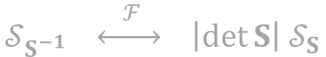








Windowing
Continuous domain
Fourier domain
$$f\left(x\right)⋅box(x)$$
$$\underset{↔}{ ℱ }$$
$$F\left(ξ\right)∗sinc ξ$$
$$S=\left(\begin{matrix}s_{1} & & \\ & ⋱ & \\ & & s_{d}\end{matrix}\right)$$
Stretching property
$${box}_{S}\left(x\right)=box(S^{−1}x)$$
$$𝒮_{S^{−1}} \underset{↔}{ ℱ }{ \left|\det{S}\right| 𝒮}_{S}$$
$$f\left(x\right)⋅{box}_{S}\left(x\right)$$
$$\underset{↔}{ ℱ }$$
$$\left|\det{S}\right|⋅F\left(ξ\right)∗sinc\left(Sξ\right)$$

Slide 14







Discrete domain windowing
Discrete domain
$${box}_{M}\left[n\right]$$
$$M=\left(\begin{matrix}m_{1} & & \\ & ⋱ & \\ & & m_{d}\end{matrix}\right)$$
$$=\left\{\begin{matrix}1 & : n∈\left[−m_{1},m_{1}\right]×⋯×\left[−m_{d},m_{d}\right] \\ 0 & : otherwise \end{matrix}\right.$$
$$m_{i}∈ℕ$$
$$↕ℱ$$
Digital Fourier domain
$$\sum_{n∈ℤ^{d}}{{box}_{M}\left[n\right]e^{−2πiω^{T}n}}$$
$$=\sum_{n_{1}={−m}_{1}}^{m_{1} }{e^{−2πiω_{1}n_{1}}}⋅⋯⋅\sum_{n_{d}={−m}_{d}}^{m_{d} }{e^{−2πiω_{d}n_{d}}}$$

Slide 15





Discrete domain windowing
Digital Fourier domain
$$\sum_{n∈ℤ^{d}}{{box}_{M}\left[n\right]e^{−2πiω^{T}n}}$$
$$= \sum_{n_{1}={−m}_{1}}^{m_{1} }{e^{−2πiω_{1}n_{1}}}⋅⋯⋅\sum_{n_{d}={−m}_{d}}^{m_{d} }{e^{−2πiω_{d}n_{d}}}$$
$$\frac{\sin\left(2π\left(m_{1}+\frac{1}{2}\right)ω_{1}\right)}{\sin{πω_{1}}}$$
$$⋅⋯⋅\frac{\sin\left(2π\left(m_{d}+\frac{1}{2}\right)ω_{d}\right)}{\sin{πω_{d}}}$$
$$=$$
Dirichlet kernel

Slide 16






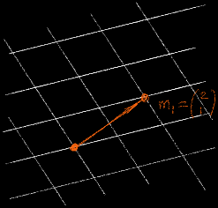

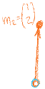
Integer sub-lattices
Integer $d×d$ matrix $M$
Sub-lattice $ℳ=Mℤ^{d}$
$⊂ℤ^{d}$
Discrete structural element:
smallest set $ℳ_{0}⊂ℤ^{d}$ such that
$$\bigcup_{m∈ℳ}{{(m+ℳ}_{0})}=ℤ^{d}$$
Discrete volume
$$vol ℳ=|ℳ_{0}|$$
$$=|\det{M}|$$

Slide 17

Integer sub-lattices
Structural element
$$ℳ_{0}=M{\left[−\frac{1}{2},\frac{1}{2}\right)}^{d}∩ℤ^{d}$$

Slide 18










Sub-sampling (a.k.a. compression)
$f$ is $ℒ_{0}$-band limited on general lattice$ℒ={Aℤ}^{d}$
$$f\left[n\right]=f(A^{∗}n)$$
sampled on${ ℒ}^{∗}={A^{∗}ℤ}^{d}={A^{−T}ℤ}^{d}$
Integer sub-lattice $ℳ^{∗}=M^{∗}ℤ^{d}⊂ℤ^{d}$
Note: dual lattice is not integer!
$$ℳ=Mℤ^{d}⊄ ℤ^{d}$$
$$M^{∗}=M^{−T}$$
$$g\left[n\right]={ ↓}_{ℳ^{∗}}\left(f\right)[n]$$
$$=f[M^{∗}n]$$
sub-sampled on $ℳ^{∗}$
$$=f(A^{∗}M^{∗}n)$$
sampled on${ ℒ}^{′∗}={A^{∗}M^{∗}ℤ}^{d}$

Slide 19







Sub-sampling (a.k.a. compression)
$$g\left[n\right]=f(A^{∗}M^{∗}n)$$
sampled on${ ℒ}^{′∗}={A^{∗}M^{∗}ℤ}^{d}$
$$G\left[ω\right]=\sum_{n∈ℤ^{d}}{f\left(A^{∗}M^{∗}n\right) e^{−2πi ω^{T}n}}$$
$$ξ=AMω$$
periodized on${ ℒ}^{′}={AMℤ}^{d}$
$$=vol{ ℒ}^{′}\sum_{p∈{ ℒ}^{′}}{F(AMω−p)}$$
$$=vol{ ℒ}^{′}\sum_{n∈ℤ^{d}}{F(AM\left(ω−n\right))}$$

Slide 20
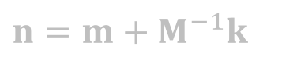





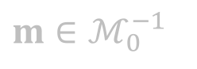
Sub-sampling (a.k.a. compression)
$$g\left[n\right]=f(A^{∗}M^{∗}n)$$
sampled on${ ℒ}^{′∗}={A^{∗}M^{∗}ℤ}^{d}$
periodized on${ ℒ}^{′}={AMℤ}^{d}$
$$G\left[ω\right]=vol{ ℒ}^{′}\sum_{n∈ℤ^{d}}{F(AM\left(ω−n\right))}$$
$$n{∈ℤ}^{d}$$
$$n=m+M^{−1}k$$
$$m∈ℳ_{0}^{−1}$$
$$k∈ℤ^{d}$$
$$=vol ℒ⋅vol ℳ\sum_{k∈ℤ^{d}}{\sum_{m∈ℳ_{0}^{−1}}{F(AM\left(ω−m−M^{−1}k\right))}}$$

Slide 21
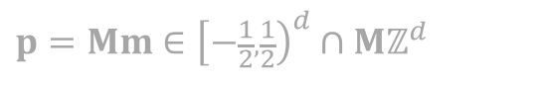

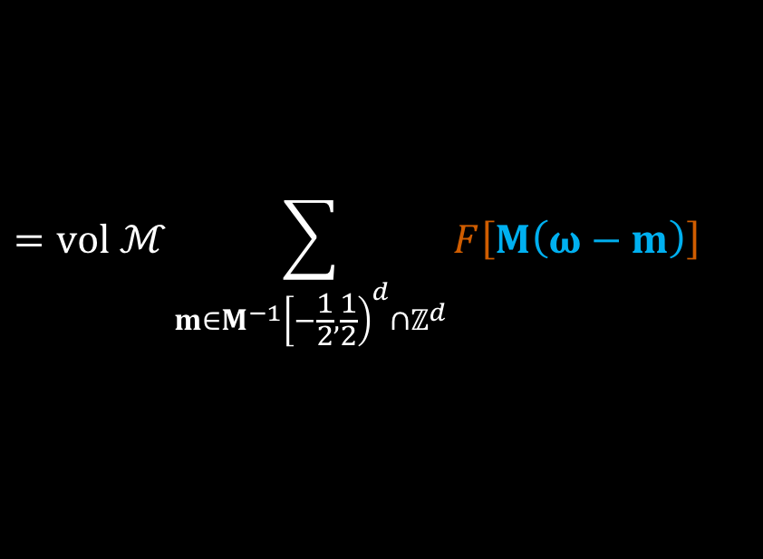
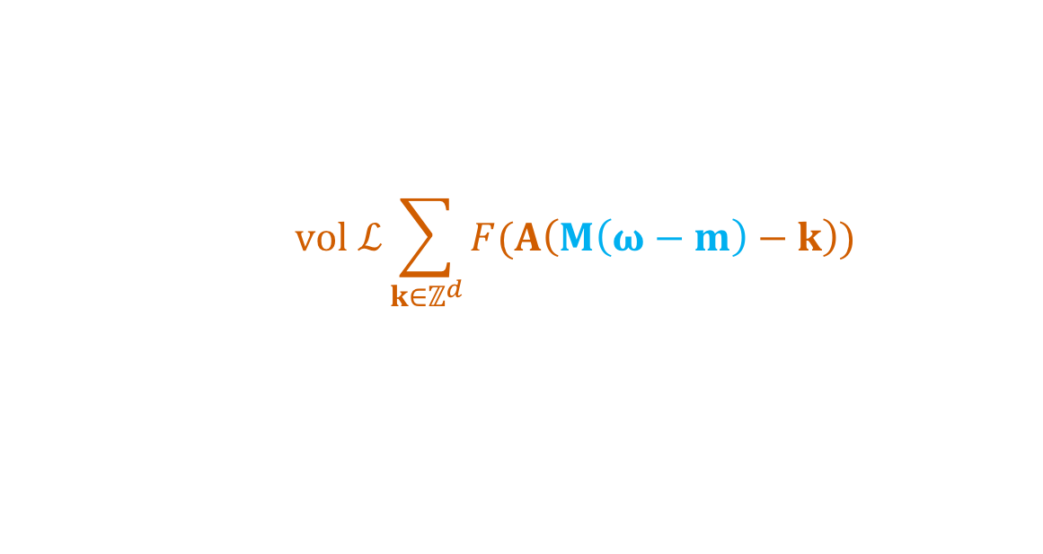

Sub-sampling (a.k.a. compression)
$$g\left[n\right]=f(A^{∗}M^{∗}n)$$
sampled on${ ℒ}^{′∗}={A^{∗}M^{∗}ℤ}^{d}$
$$G\left[ω\right]=vol ℒ⋅vol ℳ\sum_{k∈ℤ^{d}}{\sum_{m∈ℳ_{0}^{−1}}{F(A\left(M\left(ω−m\right)−k\right))}}$$
$$=vol ℳ\sum_{m∈ℳ_{0}^{−1}}{vol ℒ\sum_{k∈ℤ^{d}}{F(A\left(M\left(ω−m\right)−k\right))}}$$
$${m∈M}^{−1}{\left[−\frac{1}{2},\frac{1}{2}\right)}^{d}∩ℤ^{d}$$
$$=vol ℳ\sum_{m∈M^{−1}{\left[−\frac{1}{2},\frac{1}{2}\right)}^{d}∩ℤ^{d}}{F\left[M\left(ω−m\right)\right]}$$
$$p=Mm∈{\left[−\frac{1}{2},\frac{1}{2}\right)}^{d}∩{Mℤ}^{d}$$

Slide 22








Sub-sampling (a.k.a. compression)
Sub-sampling on$ℳ^{∗}={M^{∗}ℤ}^{d}$
Sampling on$ℒ^{∗}={A^{∗}ℤ}^{d}$
$$g\left[n\right]=f[M^{∗}n]$$
$$f\left[n\right]=f\left(A^{∗}n\right)$$
Periodization on${ \left[−\frac{1}{2},\frac{1}{2}\right)}^{d}∩{Mℤ}^{d}$
Periodization on$ℒ={Aℤ}^{d}$
$$G\left[ω\right]=vol ℳ\sum_{p∈{\left[−\frac{1}{2},\frac{1}{2}\right)}^{d}∩{Mℤ}^{d}}{F\left[Mω−p\right]}$$
$$\tilde{F}\left(ξ\right)=vol ℒ\sum_{p∈{Aℤ}^{d}}{F\left(ξ−p\right)}$$

Slide 23








Sub-sampling (a.k.a. compression)
Periodization on${ \left[−\frac{1}{2},\frac{1}{2}\right)}^{d}∩{Mℤ}^{d}$
Periodization on$ℒ={Aℤ}^{d}$
$$G\left[ω\right]=vol ℳ\sum_{p∈{\left[−\frac{1}{2},\frac{1}{2}\right)}^{d}∩{Mℤ}^{d}}{F\left[Mω−p\right]}$$
$$\tilde{F}\left(ξ\right)=vol ℒ\sum_{p∈{Aℤ}^{d}}{F\left(ξ−p\right)}$$
Aliasing unless $supp\left(F\right)⊂M{\left[−\frac{1}{2},\frac{1}{2}\right]}^{d}$
Aliasing unless $supp\left(F\right)⊂ℒ_{0}$
$$=A{\left[−\frac{1}{2},\frac{1}{2}\right]}^{d}$$
Remember: typically $\left|det M\right|<1$

Slide 24









Anti-aliasing
Anti-aliasing on $M{\left[−\frac{1}{2},\frac{1}{2}\right]}^{d}$
prior to subsampling
Ideal anti-aliasing filter
$${box}_{M}\left[ω\right]$$
$$=box\left[M^{−1}ω\right]$$
$$supp\left({box}_{M}\right)$$
$$=\left\{ω:{box}_{M}\left[ω\right]≠0\right\}$$
$$=\left\{ω:box\left[M^{−1}ω\right]≠0\right\}$$
$$=\left\{ω:box\left[M^{−1}ω\right]≠0\right\}$$
$$=\left\{Mω′:box\left[ω′\right]≠0\right\}$$
$$=M{\left[−\frac{1}{2},\frac{1}{2}\right]}^{d}$$

Slide 25


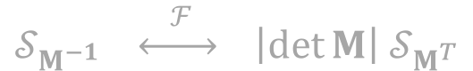


Decimation
Anti-aliasing on $M{\left[−\frac{1}{2},\frac{1}{2}\right]}^{d}$
prior to subsampling
$${H_{ℳ}\left[ω\right]=box}_{M}\left[ω\right]$$
$$=box\left[M^{−1}ω\right]$$
Stretching property
$$𝒮_{M^{−1}} \underset{↔}{ ℱ }{ \left|\det{M}\right| 𝒮}_{M^{T}}$$
$h_{ℳ}\left[n\right]=vol ℳ⋅sinc\left(M^{T}n\right)$
Decimation = anti-aliasing + subsampling
$↓_{ℳ^{∗}}\left(h_{ℳ}∗f\right)$

Slide 26





Up-sampling (a.k.a. expansion)
$f$ is $ℒ_{0}$-band limited on general lattice$ℒ={Aℤ}^{d}$
$$f\left[n\right]=f(A^{∗}n)$$
sampled on${ ℒ}^{∗}={A^{∗}ℤ}^{d}={A^{−T}ℤ}^{d}$
Lattice $𝒩^{∗}=N^{∗}ℤ^{d}⊃ℤ^{d}$
$$⟺ ℤ^{d}⊃{N^{T}ℤ}^{d}$$
$$⟺𝒩=Nℤ^{d}$$
integer sub-lattice
Expansion of $f$ onto $𝒩^{∗}$:
$$g\left[n\right]=\left(↑_{𝒩^{∗}}f\right)\left[n\right]=\left\{\begin{matrix} f[N^{∗}n] & {: N}^{∗}n∈ℤ^{d} \\ 0 & {: N}^{∗}n∉ℤ^{d}\end{matrix}\right.$$

Slide 27



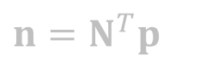
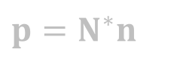


Up-sampling (a.k.a. expansion)
Expansion of $f$ onto $𝒩^{∗}$:
$$g\left[n\right]=\left\{\begin{matrix} f[N^{∗}n] & {: N}^{∗}n∈ℤ^{d} \\ 0 & {: N}^{∗}n∉ℤ^{d}\end{matrix}\right.$$
$$p=N^{∗}n$$
$$=\sum_{p∈ℤ^{d}}{f\left[p\right]δ[n−N^{T}p]}$$
$$n=N^{T}p$$
$$=F[Nω]$$
$$G\left[ω\right]=\sum_{n∈ℤ^{d}}{g\left[n\right]e^{−2πi ω^{T}n}}$$
$$=\sum_{p∈ℤ^{d}}{f\left[n\right]e^{−2πi ω^{T}N^{T}p}}$$

Slide 28









Up-sampling (a.k.a. expansion)
$$G\left[ω\right]=F\left[Nω\right]$$
Remember: typically $\left|det N\right|>1$
$⟺$ $F$ is shrunk
$⟺$ base band replicas of $F$ appear as high frequencies in $G$
Remove them so that
$$supp\left(H⋅G\right)$$
$$=\left\{ω:Nω∈{\left[−\frac{1}{2},\frac{1}{2}\right]}^{d}\right\}$$
$$=N^{−1}{\left[−\frac{1}{2},\frac{1}{2}\right]}^{d}$$
$${H_{𝒩}\left[ω\right]=box}_{N^{−1}}\left[ω\right]$$
$$=box\left[Nω\right]$$

Slide 29






Interpolation
Filtering on $N^{−1}{\left[−\frac{1}{2},\frac{1}{2}\right]}^{d}$
after up-sampling
$$H_{𝒩}\left[ω\right]$$
$$=vol 𝒩⋅box\left[Nω\right]$$
Stretching property
$$𝒮_{N} \underset{↔}{ ℱ }{ {\left|\det{N}\right|}^{−1} 𝒮}_{N^{∗}}$$
$h_{𝒩}\left[n\right]=sinc\left(N^{∗}n\right)$
Interpolation = subsampling + filtering
$$\left(↑_{𝒩^{∗}}f\right)∗h_{𝒩}$$

Slide 30





Interpolation
$$\left(\left(↑_{𝒩^{∗}}f\right)∗h_{𝒩}\right)\left[n\right]$$
$$=\sum_{p∈ℤ^{d}}{f\left[p\right]δ\left[n−N^{T}p\right]∗h_{𝒩}\left[n\right]}$$
$$=\sum_{p∈ℤ^{d}}{f\left[p\right]h_{𝒩}\left[n−N^{T}p\right]}$$
$$=\sum_{p∈ℤ^{d}}{f\left[p\right]sinc\left(N^{∗}\left(n−N^{T}p\right)\right)}$$
$$=\sum_{p∈ℤ^{d}}{f\left[p\right]sinc\left(N^{∗}n−p\right)}$$

Slide 31










Interpolation
$F\left[Nω\right]$ $H_{𝒩}\left[ω\right]$
$$=F\left[Nω\right]H_{𝒩}\left[ω\right]$$
$$=\tilde{F}\left(ANω\right)H_{𝒩}\left[ω\right]$$
$$=vol ℒ⋅\sum_{n∈ℤ^{d}}{F(ANω−An)H_{𝒩}\left[ω\right]}$$
$$ℒ^{}=Aℤ^{d}$$
$$=\frac{vol ℒ′}{vol 𝒩}⋅\sum_{n∈ℤ^{d}}{F(AN(ω−N^{−1}n))H_{𝒩}\left[ω\right]}$$
$$ℒ^{′}=ANℤ^{d}$$
$$=vol ℒ′⋅\sum_{m∈ℤ^{d}}{F(AN\left(ω−m\right)) }$$
$$H_{𝒩}\left[ω\right]=$$
$$vol 𝒩 box\left[Nω\right]$$

Slide 32





Interpolation
Band-limited interpolation on a finer lattice
$$\left(\left(↑_{𝒩^{∗}}f\right)∗h_{𝒩}\right)\left[n\right]$$
$$=\sum_{p∈ℤ^{d}}{f\left[p\right]sinc\left(N^{∗}n−p\right)}$$
Sampling continuous signal on a denser lattice
$$ℒ^{′}=ANℤ^{d}$$
$$=vol ℒ′⋅\sum_{m∈ℤ^{d}}{F(AN\left(ω−m\right)) }$$
$F\left[Nω\right]$ $H_{𝒩}\left[ω\right]$

Slide 33



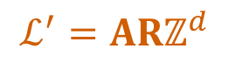

Resampling
Decimation: resampling on integer sub-lattice $ℳ^{∗}=M^{∗}ℤ^{d}⊂ℤ^{d}$
Interpolation: resampling on $𝒩^{∗}=N^{∗}ℤ^{d}$ with integer inverse $𝒩=Nℤ^{d}$
Can we resample onto an arbitrary lattice ?
$$ℛ^{∗}=R^{∗}ℤ^{d}$$
akin to sampling on
$$ℒ^{′}=ARℤ^{d}$$
Yes! If
$R=NM$
$⟺R^{∗}=N^{∗}M^{∗}$
such that are integer
$$M^{∗},N$$
Generalization of rational factor to lattices

Slide 34


Resampling
First up-sample, then sub-sample
$$↓_{ℳ^{∗}}\left(\left(↑_{𝒩^{∗}}f\right)∗h_{𝒩}∗h_{ℳ}\right)\left[n\right]$$
Filters may be combined

Slide 35









Properties of resampling
$$↓_{M_{1}^{∗}}{(↓}_{M_{2}^{∗}}f)\left[n\right]=$$
$$↓_{M_{1}^{∗}}f\left[M_{2}^{∗}n\right]$$
$$=f\left[{M_{1}^{∗}M}_{2}^{∗}n\right]$$
$${=(↓}_{M_{1}^{∗}M_{2}^{∗}}f)\left[n\right]$$
$$↓_{M_{1}^{∗}}↓_{M_{2}^{∗}} = ↓_{M_{1}^{∗}M_{2}^{∗}}$$
$$ℱ(↑_{N_{1}^{∗}}{(↑}_{N_{2}^{∗}}f))\left[ω\right]=$$
$$F\left[N_{2}N_{1}ω\right]$$
$$=ℱ(↑_{{N_{1}^{∗}N}_{2}^{∗}}f)\left[ω\right]$$
$$↑_{N_{1}^{∗}}↑_{N_{2}^{∗} }={ ↑}_{{N_{1}^{∗}N}_{2}^{∗}}$$

Slide 36






Properties of resampling
$$↓_{N^{T} }(↑_{N^{∗}}f)\left[n\right]=$$
$$↓_{N^{−∗} }\left\{\begin{matrix} f[N^{∗}n] & {: N}^{∗}n∈ℤ^{d} \\ 0 & {: N}^{∗}n∉ℤ^{d}\end{matrix}\right.$$
$$=f[n]$$
$$=\left\{\begin{matrix} f[N^{∗}N^{T}n] & {: N}^{∗}N^{T}n∈ℤ^{d} \\ 0 & {: N}^{∗}N^{T}n∉ℤ^{d}\end{matrix}\right.$$
$$↓_{N^{−∗} }↑_{N^{∗}} =id$$
$$Generally ↑_{M^{−∗} }↓_{M^{∗}}≠id$$

Slide 37








Linearity of resampling
$$↓_{M^{∗}}(αf+βg)\left[n\right]=$$
$$(αf+βg)\left[M^{∗}n\right]$$
$$=αf\left[M^{∗}n\right]+βg\left[M^{∗}n\right]$$
$$=α↓_{M^{∗}}\left(f\right)\left[n\right]+β↓_{M^{∗}}(g)\left[n\right]$$
linearity
$$↑_{N^{∗}}(αf+βg)\left[n\right]=$$
$$\left\{\begin{matrix} \left(αf+βg\right)[N^{∗}n] & {: N}^{∗}n∈ℤ^{d} \\ 0 & {: N}^{∗}n∉ℤ^{d}\end{matrix}\right.$$
$$=α\left\{\begin{matrix} f[N^{∗}n] & {: N}^{∗}n∈ℤ^{d} \\ 0 & {: N}^{∗}n∉ℤ^{d}\end{matrix}\right.+β\left\{\begin{matrix} g[N^{∗}n] & {: N}^{∗}n∈ℤ^{d} \\ 0 & {: N}^{∗}n∉ℤ^{d}\end{matrix}\right.$$
$$=α↑_{N^{∗}}\left(f\right)\left[n\right]+β↑_{N^{∗}}(g)\left[n\right]$$
linearity

Slide 38







Sub-sampling and translation
$$({τ_{m}↓}_{M^{∗}}f)\left[n\right]=$$
$$τ_{m}f[M^{∗}n]$$
$$=f[M^{∗}(n−m)]$$
$$=f[M^{∗}n−M^{∗}m]$$
$$=τ_{M^{∗}m}f[M^{∗}n]$$
$$=(↓_{M^{∗}}τ_{M^{∗}m}f)\left[n\right]$$
$${τ_{m}↓}_{M^{∗}} = ↓_{M^{∗}}τ_{M^{∗}m}$$
not equivariant!

Slide 39







Up-sampling and translation
$$(↑_{N^{∗}}τ_{m}f)\left[n\right]=$$
$\left\{\begin{matrix} f[N^{∗}n−m] & {: N}^{∗}n∈ℤ^{d} \\ 0 & {: N}^{∗}n∉ℤ^{d}\end{matrix}\right.$
$=\left\{\begin{matrix} f[N^{∗}\left(n−N^{T}m\right)] & {: N}^{∗}n∈ℤ^{d} \\ 0 & {: N}^{∗}n∉ℤ^{d}\end{matrix}\right.$
$=\left\{\begin{matrix} f[N^{∗}\left(n−N^{T}m\right)] & {: N}^{∗}(n−N^{T}m)∈ℤ^{d} \\ 0 & {: N}^{∗}(n−N^{T}m)∉ℤ^{d}\end{matrix}\right.$
$$=\left(↑_{N^{∗}}f\right)\left[n−N^{T}m\right]$$
$$=(τ_{N^{T}m}↑_{N^{∗}}f)\left[n\right]$$
$$↑_{N^{∗}}τ_{m}=τ_{N^{T}m}↑_{N^{∗}}$$
not equivariant!

Slide 40




Resampling and filtering
Linear translation equivariant system
$$\sum_{m∈ℤ^{d}}{h\left[m\right]f[n−m] }$$
$$(ℋf)\left[n\right]=$$
$$(h∗f)\left[n\right]=$$
$$=\left(\sum_{m∈ℤ^{d}}{h\left[m\right]τ_{m}}\right)f\left[n\right]$$

Slide 41





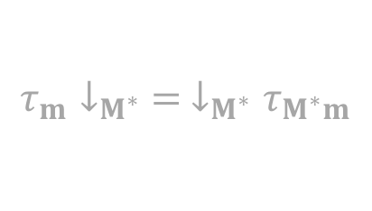

Sub-sampling and filtering
Combining linearity and translation properties
$${τ_{m}↓}_{M^{∗}} = ↓_{M^{∗}}τ_{M^{∗}m}$$
$$=\left(\sum_{m∈ℤ^{d}}{h\left[m\right]τ_{m}}\right)↓_{M^{∗}}$$
$$=\sum_{m∈ℤ^{d}}{h\left[m\right]τ_{m}}↓_{M^{∗}}$$
$$ℋ↓_{M^{∗}}$$
$$=\left(\sum_{m∈ℤ^{d}}{h\left[m\right]{↓_{M^{∗}}τ}_{M^{∗}m}}\right)$$
$$=↓_{M^{∗}}\left(\sum_{m∈ℤ^{d}}{h\left[m\right]τ_{M^{∗}m}}\right)$$
$$=↓_{M^{∗}}𝒢$$

Slide 42





Sub-sampling and filtering
$$𝒢=\sum_{m∈ℤ^{d}}{h\left[m\right]τ_{M^{∗}m}}$$
$$=\sum_{p∈{M^{∗}ℤ}^{d}}{h\left[M^{T}p\right]τ_{p}}$$
$$M^{∗}m=p$$
Expanded impulse response
$$g\left[n\right]=\left\{\begin{matrix} h[M^{T}n] & {:M}^{T}n∈ℤ^{d} \\ 0 & {:M}^{T}n∉ℤ^{d}\end{matrix}\right.$$
$$= ↑_{M^{T}}h$$

Slide 43




Sub-sampling and filtering
$$𝒢=\sum_{m∈ℤ^{d}}{h\left[m\right]τ_{M^{∗}m}}$$
In the Fourier domain
$$G[ω]=\sum_{n∈ℤ^{d}}{h\left[n\right]e^{−2πi ω^{T}M^{∗}n}}$$
$$=\sum_{n∈ℤ^{d}}{h\left[n\right]e^{−2πi {\left(M^{−1}ω\right)}^{T}n}}$$
$$=H[M^{−1}ω]$$

Slide 44




Sub-sampling and filtering
$$ℋ↓_{M^{∗}}$$
$$= ↓_{M^{∗}}𝒢$$
$$g= ↑_{M^{T}}h$$
“Noble” identity
$${h∗(↓}_{M^{∗}}f)={↓_{M^{∗}}((↑}_{M^{T}}h)∗f)$$

Slide 45
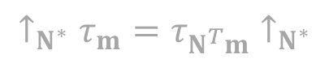






Up-sampling and filtering
Combining linearity and translation properties
$$↑_{N^{∗}}τ_{m}=τ_{N^{T}m}↑_{N^{∗}}$$
$$=↑_{N^{∗}}\left(\sum_{m∈ℤ^{d}}{h\left[m\right]τ_{m}}\right)$$
$$=\sum_{m∈ℤ^{d}}{h\left[m\right]{↑_{N^{∗}}τ}_{m}}$$
$$↑_{N^{∗}}ℋ$$
$$=\sum_{m∈ℤ^{d}}{h\left[m\right]τ_{N^{T}m}↑_{N^{∗}}}$$
$$=\left(\sum_{m∈ℤ^{d}}{h\left[m\right]τ_{N^{T}m}}\right)↑_{N^{∗}}$$
$$=𝒢↑_{N^{∗}}$$

Slide 46







Up-sampling and filtering
$$𝒢=\sum_{m∈ℤ^{d}}{h\left[m\right]τ_{N^{T}m}}$$
$$=\sum_{p∈{N^{T}ℤ}^{d}}{h\left[N^{∗}p\right]τ_{p}}$$
$$N^{T}m=p$$
Expanded impulse response
$$g\left[n\right]=\left\{\begin{matrix} h[N^{∗}n] & {:N}^{∗}n∈ℤ^{d} \\ 0 & :{ N}^{∗}n∉ℤ^{d}\end{matrix}\right.$$
$$= ↑_{N^{∗}}h$$
$$G[ω]=\sum_{n∈ℤ^{d}}{h\left[n\right]e^{−2πi ω^{T}N^{T}n}}$$
$$=H[Nω]$$

Slide 47



Up-sampling and filtering
$$↑_{N^{∗}}ℋ$$
$$=𝒢↑_{N^{∗}}$$
$$g= ↑_{N^{∗}}h$$
“Noble” identity
$$↑_{N^{∗}} \left(h∗f\right)=\left(↑_{N^{∗}}h\right)∗(↑_{N^{∗}}f)$$

Slide 48








Polyphase representation
$$ℋ=\sum_{n∈ℤ^{d}}{h\left[n\right]τ_{n}}$$
$$ℳ^{∗}={M^{∗}ℤ}^{d}$$
$$n=M^{∗}m+k$$
$$=\sum_{m∈ℳ_{0}^{∗}}{\sum_{k∈ℤ^{d}}{h\left[M^{∗}k+m \right]τ_{M^{∗}k+m }}}$$
$$m∈ℳ_{0}^{∗} k∈ℤ^{d}$$
type I polyphase decomposition:
$$=\sum_{m∈ℳ_{0}^{∗}}{\sum_{k∈ℤ^{d}}{e_{m}\left[k\right]τ_{M^{∗}k+m }}}$$
$$e_{m}\left[k\right]=h\left[M^{∗}k+m \right]$$
$$=\sum_{m∈ℳ_{0}^{∗}}{\left(\sum_{k∈ℤ^{d}}{e_{m}\left[k\right]τ_{M^{∗}k }}\right)τ_{m }}$$

Slide 49

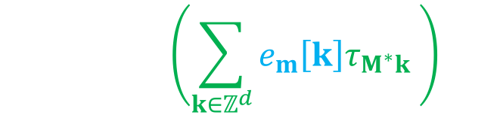


Polyphase representation
$$ℋ=\sum_{m∈ℳ_{0}^{∗}}{\left(\sum_{k∈ℤ^{d}}{e_{m}\left[k\right]τ_{M^{∗}k }}\right)τ_{m }}$$
type I polyphase decomposition:
$$e_{m}\left[k\right]=h\left[M^{∗}k+m \right]$$
expanded impulse response
$$↑_{M^{T}}e_{m}$$
$$ℋf=\sum_{m∈ℳ_{0}^{∗}}{\left(↑_{M^{T}}e_{m}\right)∗τ_{m }f}$$

Slide 50
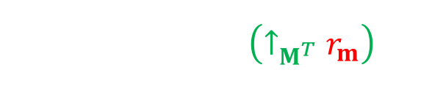
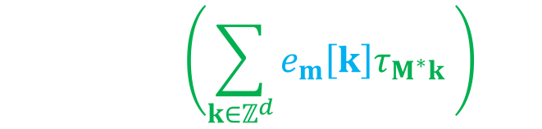
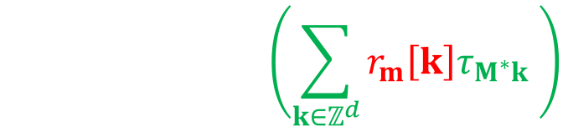
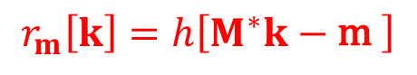

Polyphase representation
$$ℋ=\sum_{m∈ℳ_{0}^{∗}}{\left(\sum_{k∈ℤ^{d}}{e_{m}\left[k\right]τ_{M^{∗}k }}\right)τ_{m }}$$
type I polyphase decomposition:
$$ℋf=\sum_{m∈ℳ_{0}^{∗}}{\left(↑_{M^{T}}e_{m}\right)∗τ_{m }f}$$
$$e_{m}\left[k\right]=h\left[M^{∗}k+m \right]$$
type II polyphase decomposition:
$$ℋ=\sum_{m∈ℳ_{0}^{∗}}{τ_{−m }\left(\sum_{k∈ℤ^{d}}{r_{m}\left[k\right]τ_{M^{∗}k }}\right)}$$
$$r_{m}\left[k\right]=h\left[M^{∗}k−\text{m} \right]$$
$$ℋf=\sum_{m∈ℳ_{0}^{∗}}{τ_{−m }\left(↑_{M^{T}}r_{m}\right)∗f}$$

Slide 51

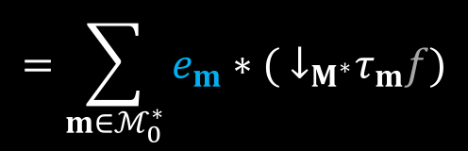

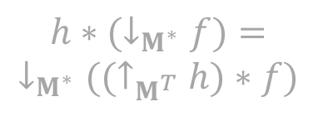
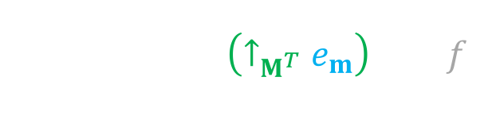
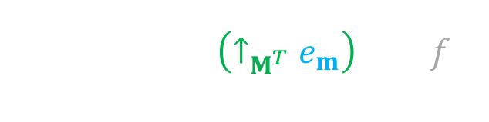
Efficient implementation of decimation
Type I polyphase representation on $ℳ^{∗}$
$$={ ↓}_{M^{∗}}\left(\sum_{m∈ℳ_{0}^{∗}}{\left(↑_{M^{T}}e_{m}\right)∗τ_{m}f}\right)$$
$↓_{M^{∗}}$ $ℋf$
$$=\sum_{m∈ℳ_{0}^{∗}}{{ ↓}_{M^{∗}}\left(\left(↑_{M^{T}}e_{m}\right)∗τ_{m}f\right)}$$
$${h∗(↓}_{M^{∗}}f)=$$
$${↓_{M^{∗}}((↑}_{M^{T}}h)∗f)$$
$$=\sum_{m∈ℳ_{0}^{∗}}{e_{m}∗{({ ↓}_{M^{∗}}τ}_{m}f)}$$

Slide 52
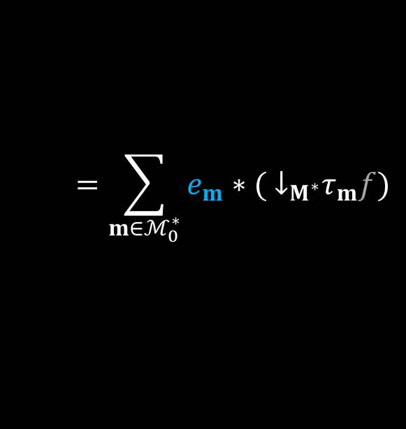

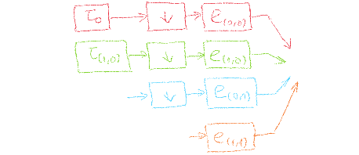



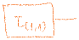
Efficient implementation of decimation
$$=\sum_{m∈ℳ_{0}^{∗}}{e_{m}∗{({ ↓}_{M^{∗}}τ}_{m}f)}$$
$↓_{M^{∗}}$ $ℋf$

Slide 53


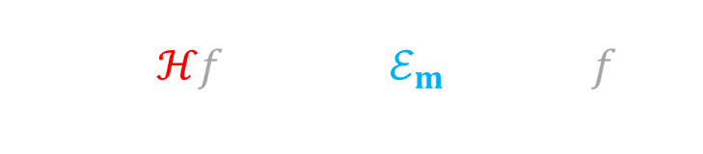

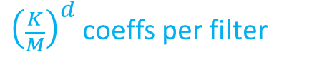


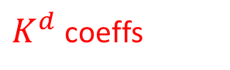

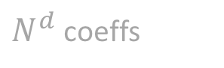


Efficient implementation of decimation
Assume $M^{∗}=MI$
$$ℳ_{0}^{∗}={\left\{0,…,M−1\right\}}^{d}$$
$$↓_{M^{∗}} ℋf=\sum_{m∈ℳ_{0}^{∗}}{ℰ_{m}{({ ↓}_{M^{∗}}τ}_{m}f)}$$
$$supp\left(f\right)={\left\{0,…,N−1\right\}}^{d}$$
$N^{d}$ coeffs
$N$ divisible by $M$
$$supp\left(h\right)={\left\{0,…,K−1\right\}}^{d}$$
$K^{d}$ coeffs
$K$ divisible by $M$
$$supp\left(e_{m}\right)={\left\{0,…, \frac{K}{M }−1\right\}}^{d}$$
${\left(\frac{K}{M}\right)}^{d}$ coeffs per filter
$M$ filters

Slide 54



Efficient implementation of decimation
Assume $M^{∗}=MI$
$$ℳ_{0}^{∗}={\left\{0,…,M−1\right\}}^{d}$$
$$↓_{M^{∗}} ℋf=\sum_{m∈ℳ_{0}^{∗}}{ℰ_{m}{({ ↓}_{M^{∗}}τ}_{m}f)}$$
${\left(KN\right)}^{d}$ MACCs
${\left(\frac{K}{M}\frac{N}{M}\right)}^{d}×M^{d}={\left(\frac{KN}{M}\right)}^{d}$MACCs
Saving factor $M^{d}$

Slide 55
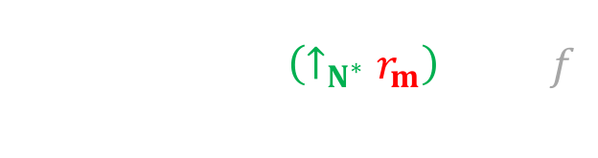


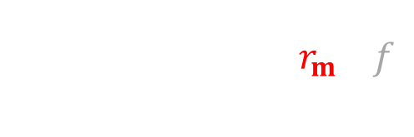
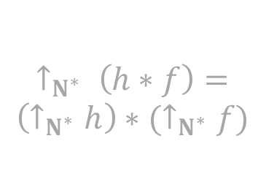
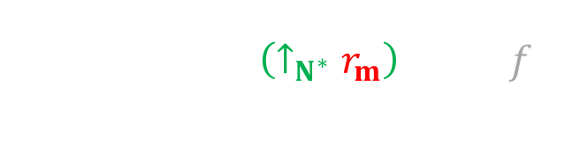
Efficient implementation of interpolation
Type II polyphase representation on $𝒩^{T}$
$$=\left(\sum_{m∈𝒩_{0}^{T}}{τ_{−m }\left(↑_{N^{∗}}r_{m}\right)}\right)↑_{N^{∗}}f$$
$ℋ$ $↑_{N^{∗}}f$
$$=\sum_{m∈𝒩_{0}^{T}}{τ_{−m }\left(\left(↑_{N^{∗}}r_{m}\right)∗{(↑}_{N^{∗}}f)\right)}$$
$$↑_{N^{∗}} \left(h∗f\right)=$$
$$\left(↑_{N^{∗}}h\right)∗(↑_{N^{∗}}f)$$
$$=\sum_{m∈𝒩_{0}^{T}}{τ_{−m }↑_{N^{∗}}r_{m}∗f}$$

